Slide 1


BCSE307L – Compiler Design
Module 4 – Intermediate-Code Generation

Slide 2
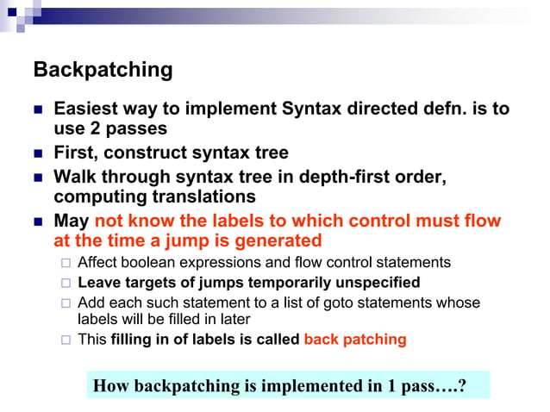

Slide 3
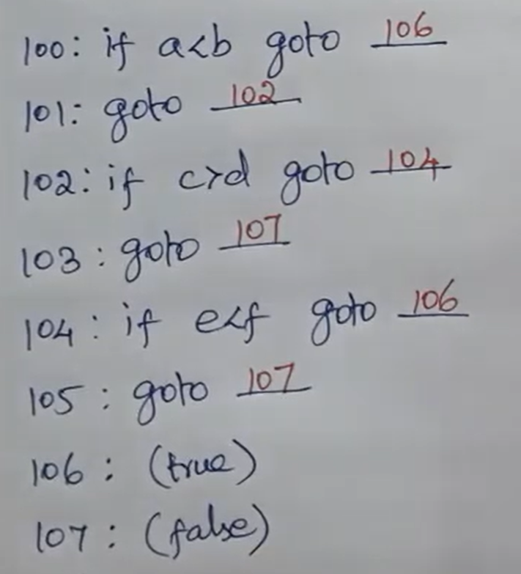
Backpatching
Problem generated by short-circuit code in generation of 3ac
Backpatching is a technique used in compiler design to delay the assignment of addresses to code or data structures until a later stage of the compilation process.
This allows the compiler to generate code with placeholder addresses that are later updated or "backpatched" with the correct addresses once they are known.
Backpatching is commonly used in compilers for languages that support complex control structures or dynamic memory allocation.
Leaves the label unspecified and fill it later
Ex: a<b or c>d and e<f

Slide 4
Functions in backpatching
Makelist(i) – creates a new list with index, i
Merge(L1, L2) – concatenate List, L1 with list, L2
Backpatch(L, label) – fills all 3ac in list, L with the target, Label
Nextquad – gives index of next quadruple

Slide 5
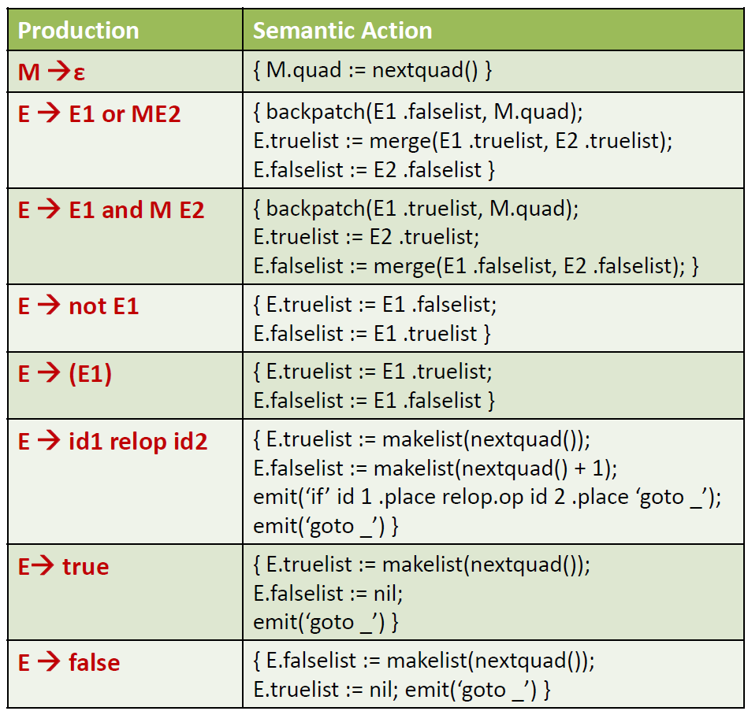
Semantic rules for Boolean expression statements to incorporate backpatching

Slide 6
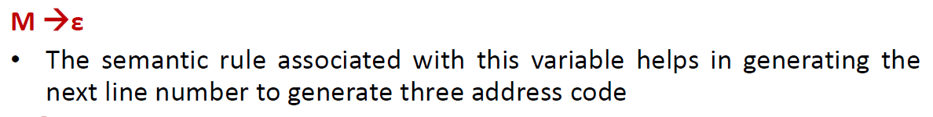
Semantic rules for Boolean expression statements to incorporate backpatching

Slide 7
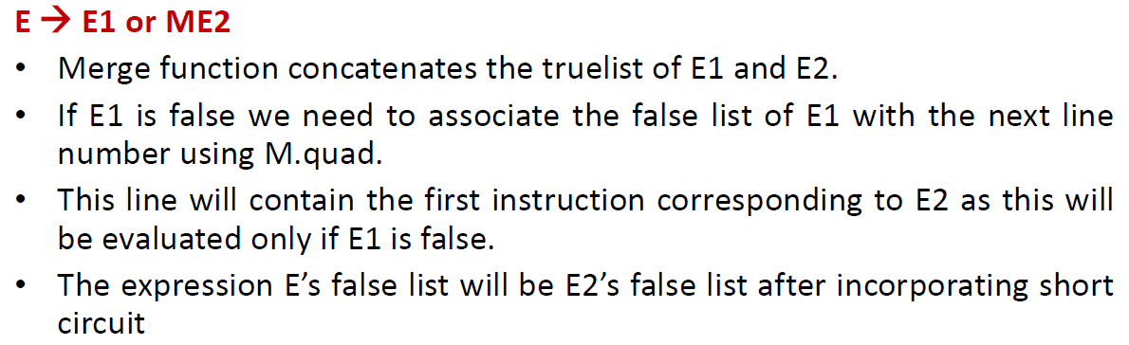
Semantic rules for Boolean expression statements to incorporate backpatching

Slide 8
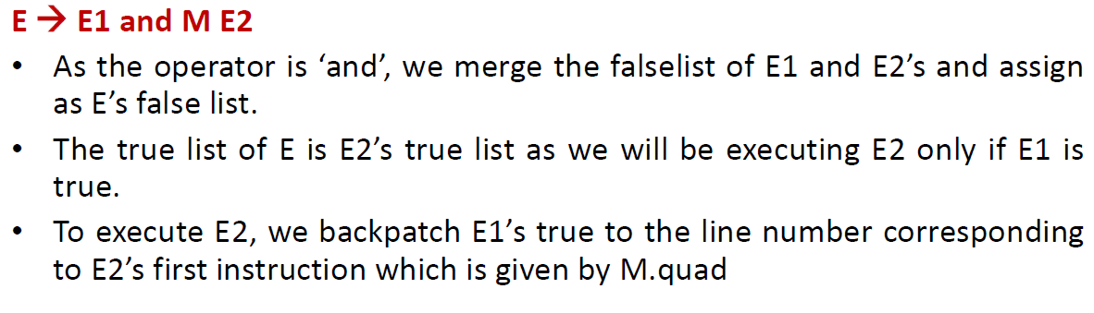
Semantic rules for Boolean expression statements to incorporate backpatching

Slide 9
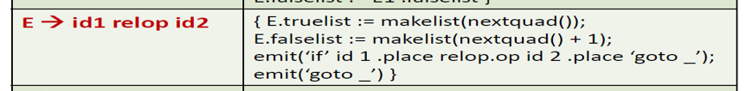
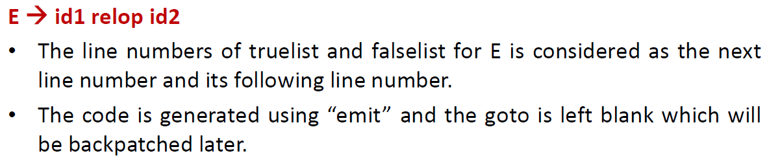
Semantic rules for Boolean expression statements to incorporate backpatching

Slide 10
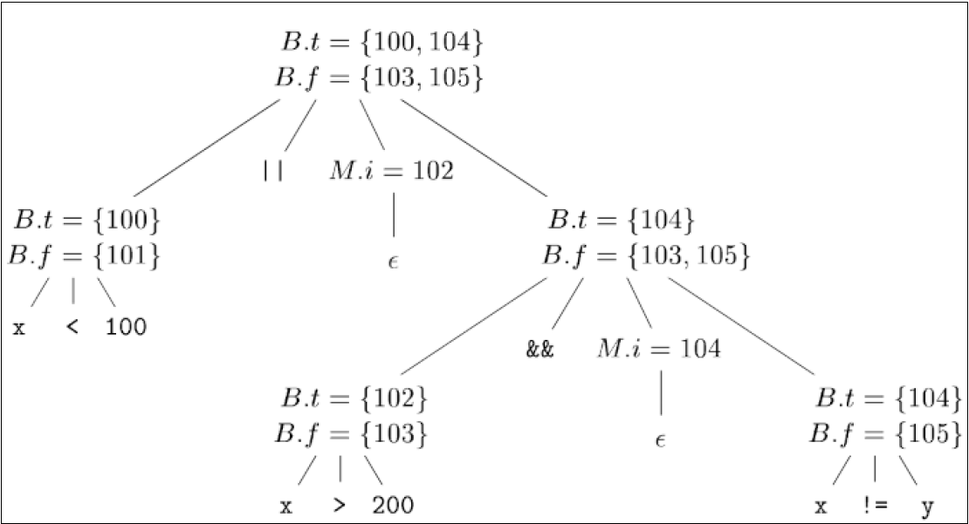
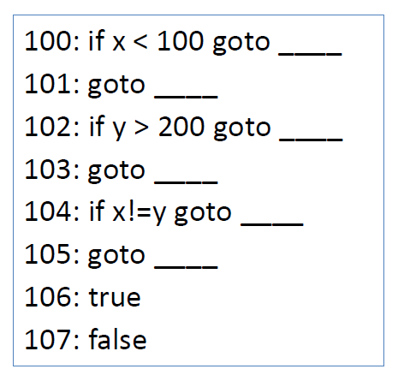
Example 1:Boolean expression statements

Slide 11
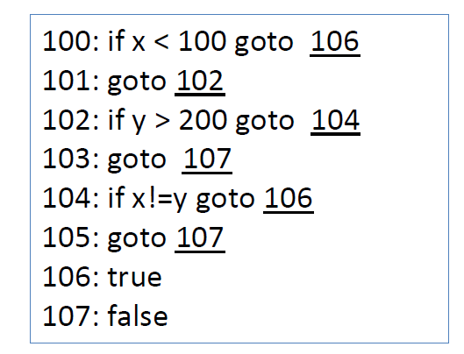
Example 1:Boolean expression statements

Slide 12
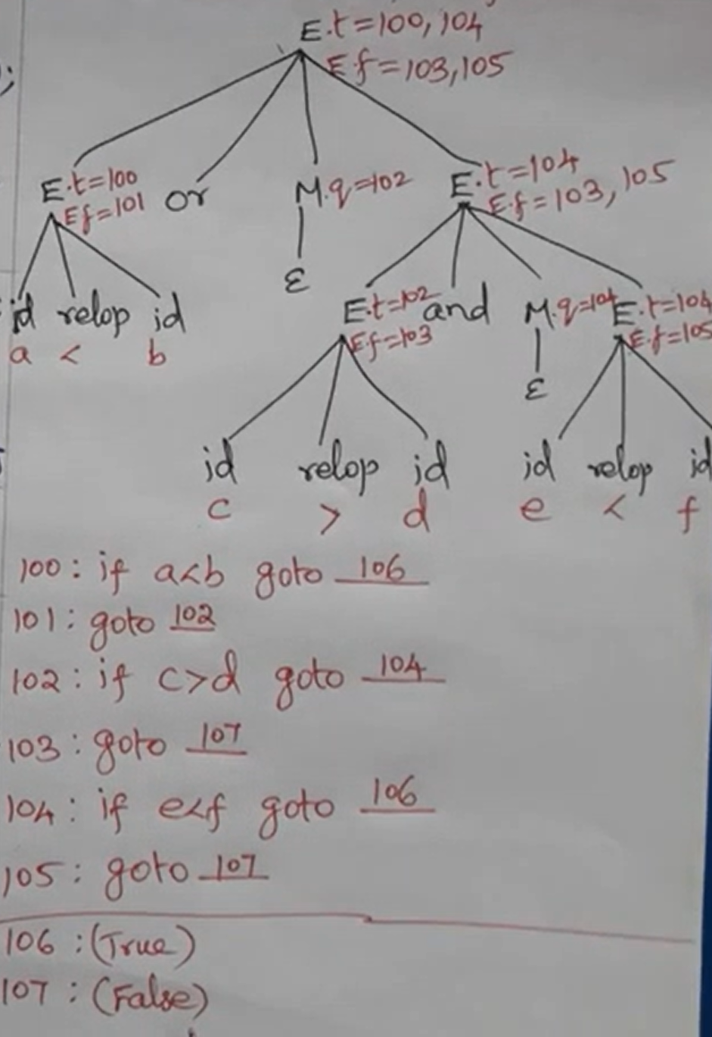
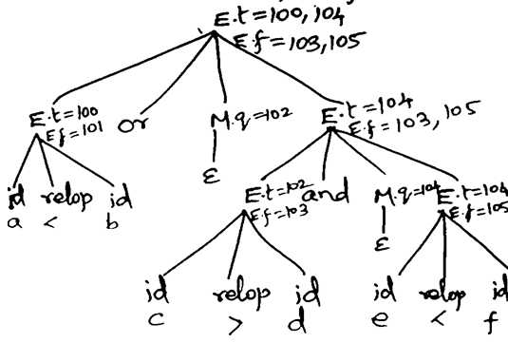
Example 1
a<b or c>d and e<f

Slide 13
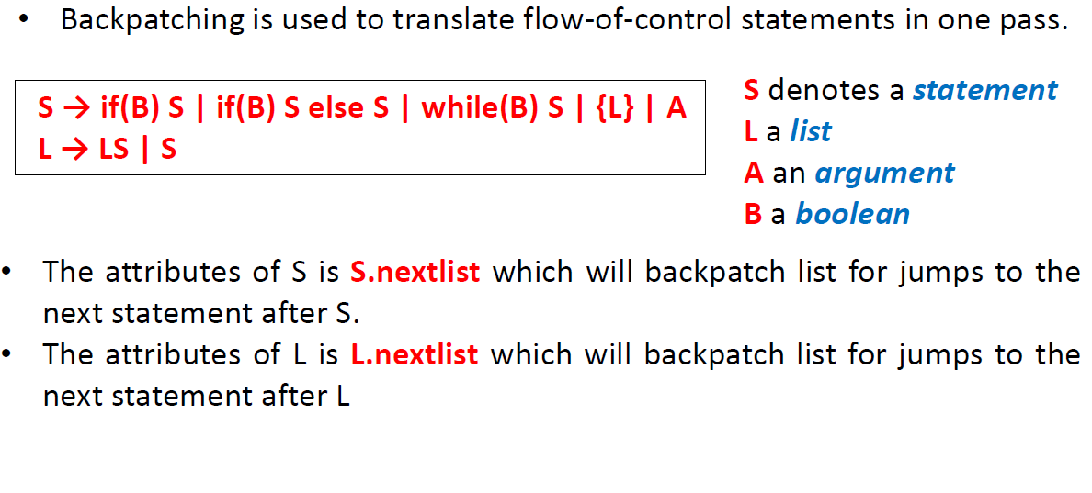
Semantic rules for control flow statements to incorporate backpatching

Slide 14
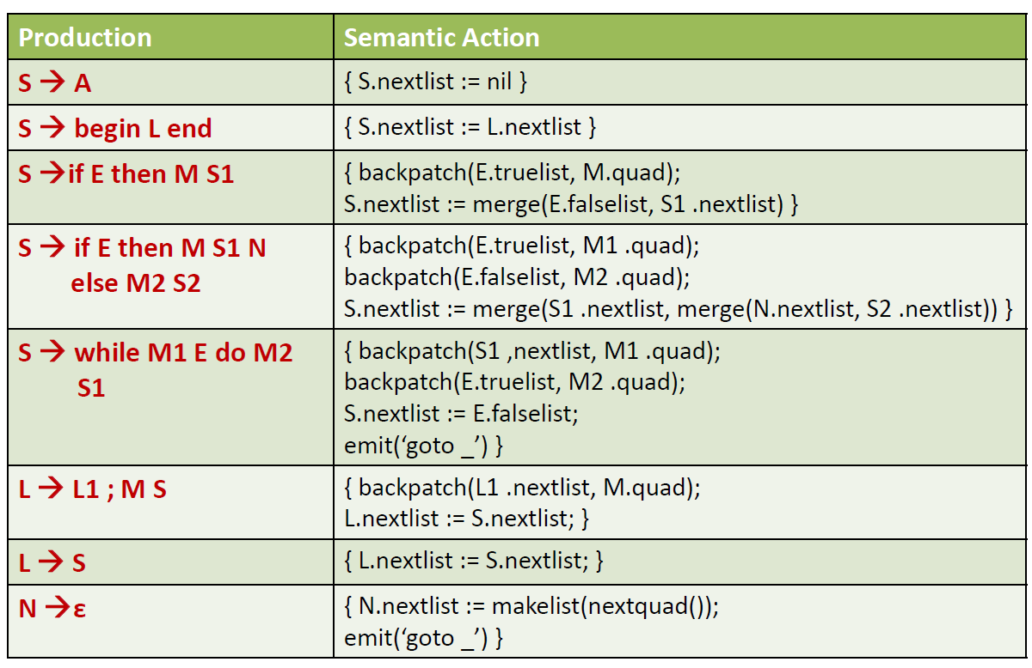
Semantic rules for control flow statements to incorporate backpatching

Slide 15
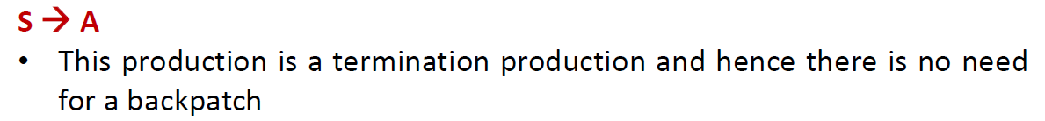
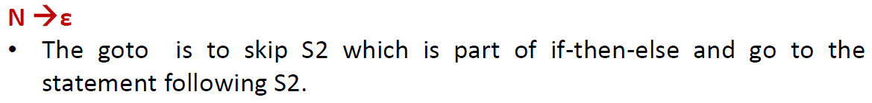
Semantic rules for control flow statements to incorporate backpatching

Slide 16
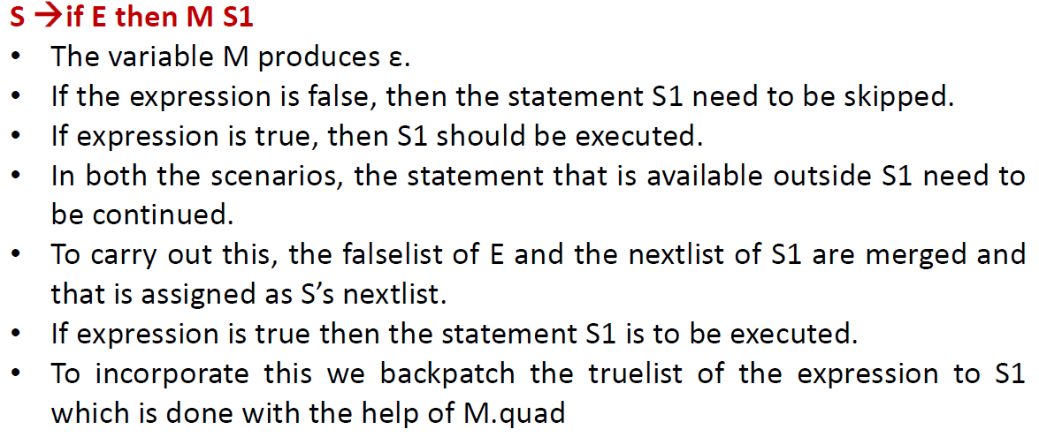
Semantic rules for control flow statements to incorporate backpatching

Slide 17
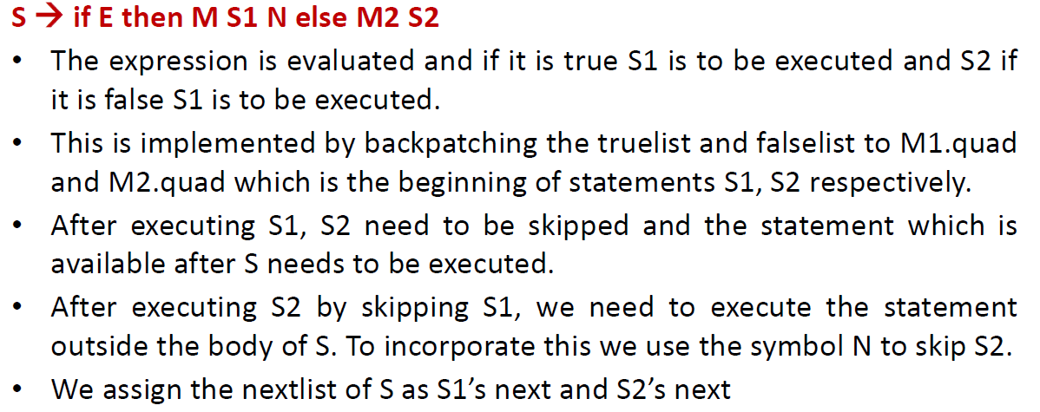
Semantic rules for control flow statements to incorporate backpatching

Slide 18
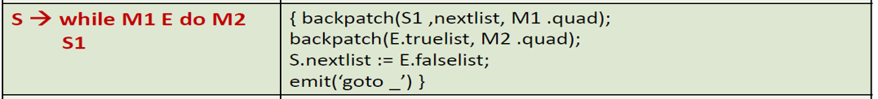
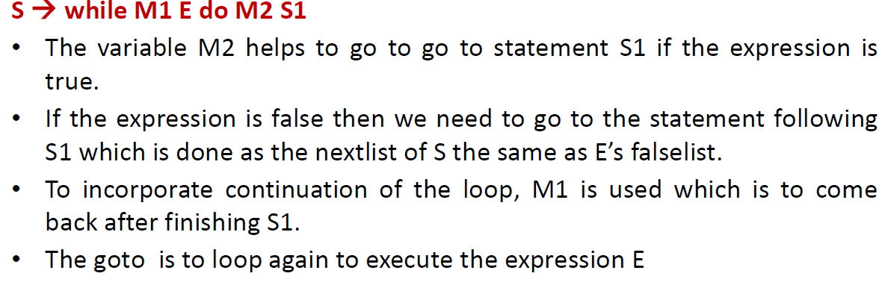
Semantic rules for control flow statements to incorporate backpatching

